Slide 1
The impacts of COVID-19 pandemic on public transit demand in the United States
Luyu Liu
2021.1.29

Slide 2
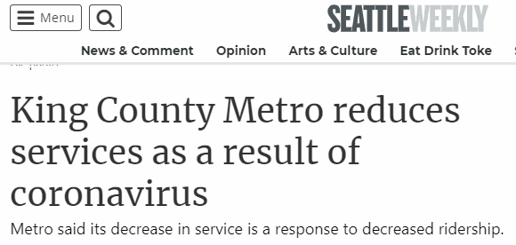
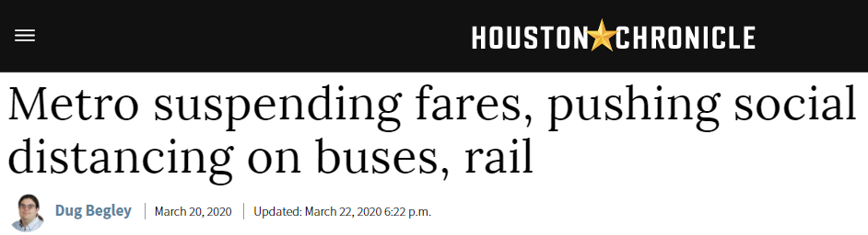
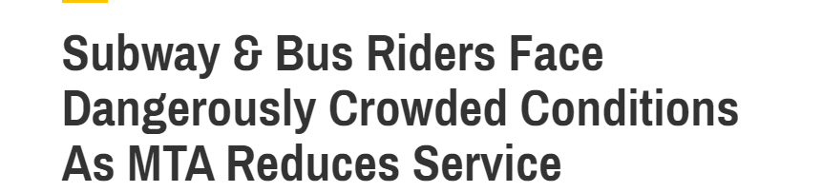
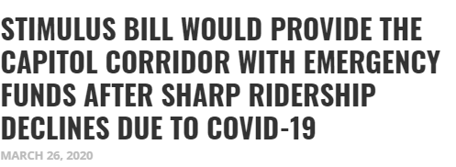
Transit in a crisis
Seattle: decreased for 60% of ridership
Houston: decreased for 29% of ridership
NYC: decreased for 70% of ridership
Sacramento: decreased for 90% - 95% of ridership

Slide 3
Research questions
How many people continue to transit during the lockdown?
What factors were correlated to the demand?
How did passengers in different cities respond to the pandemic?
How did the pandemic reshape our commuting pattern?

Slide 4
Data source

Slide 5
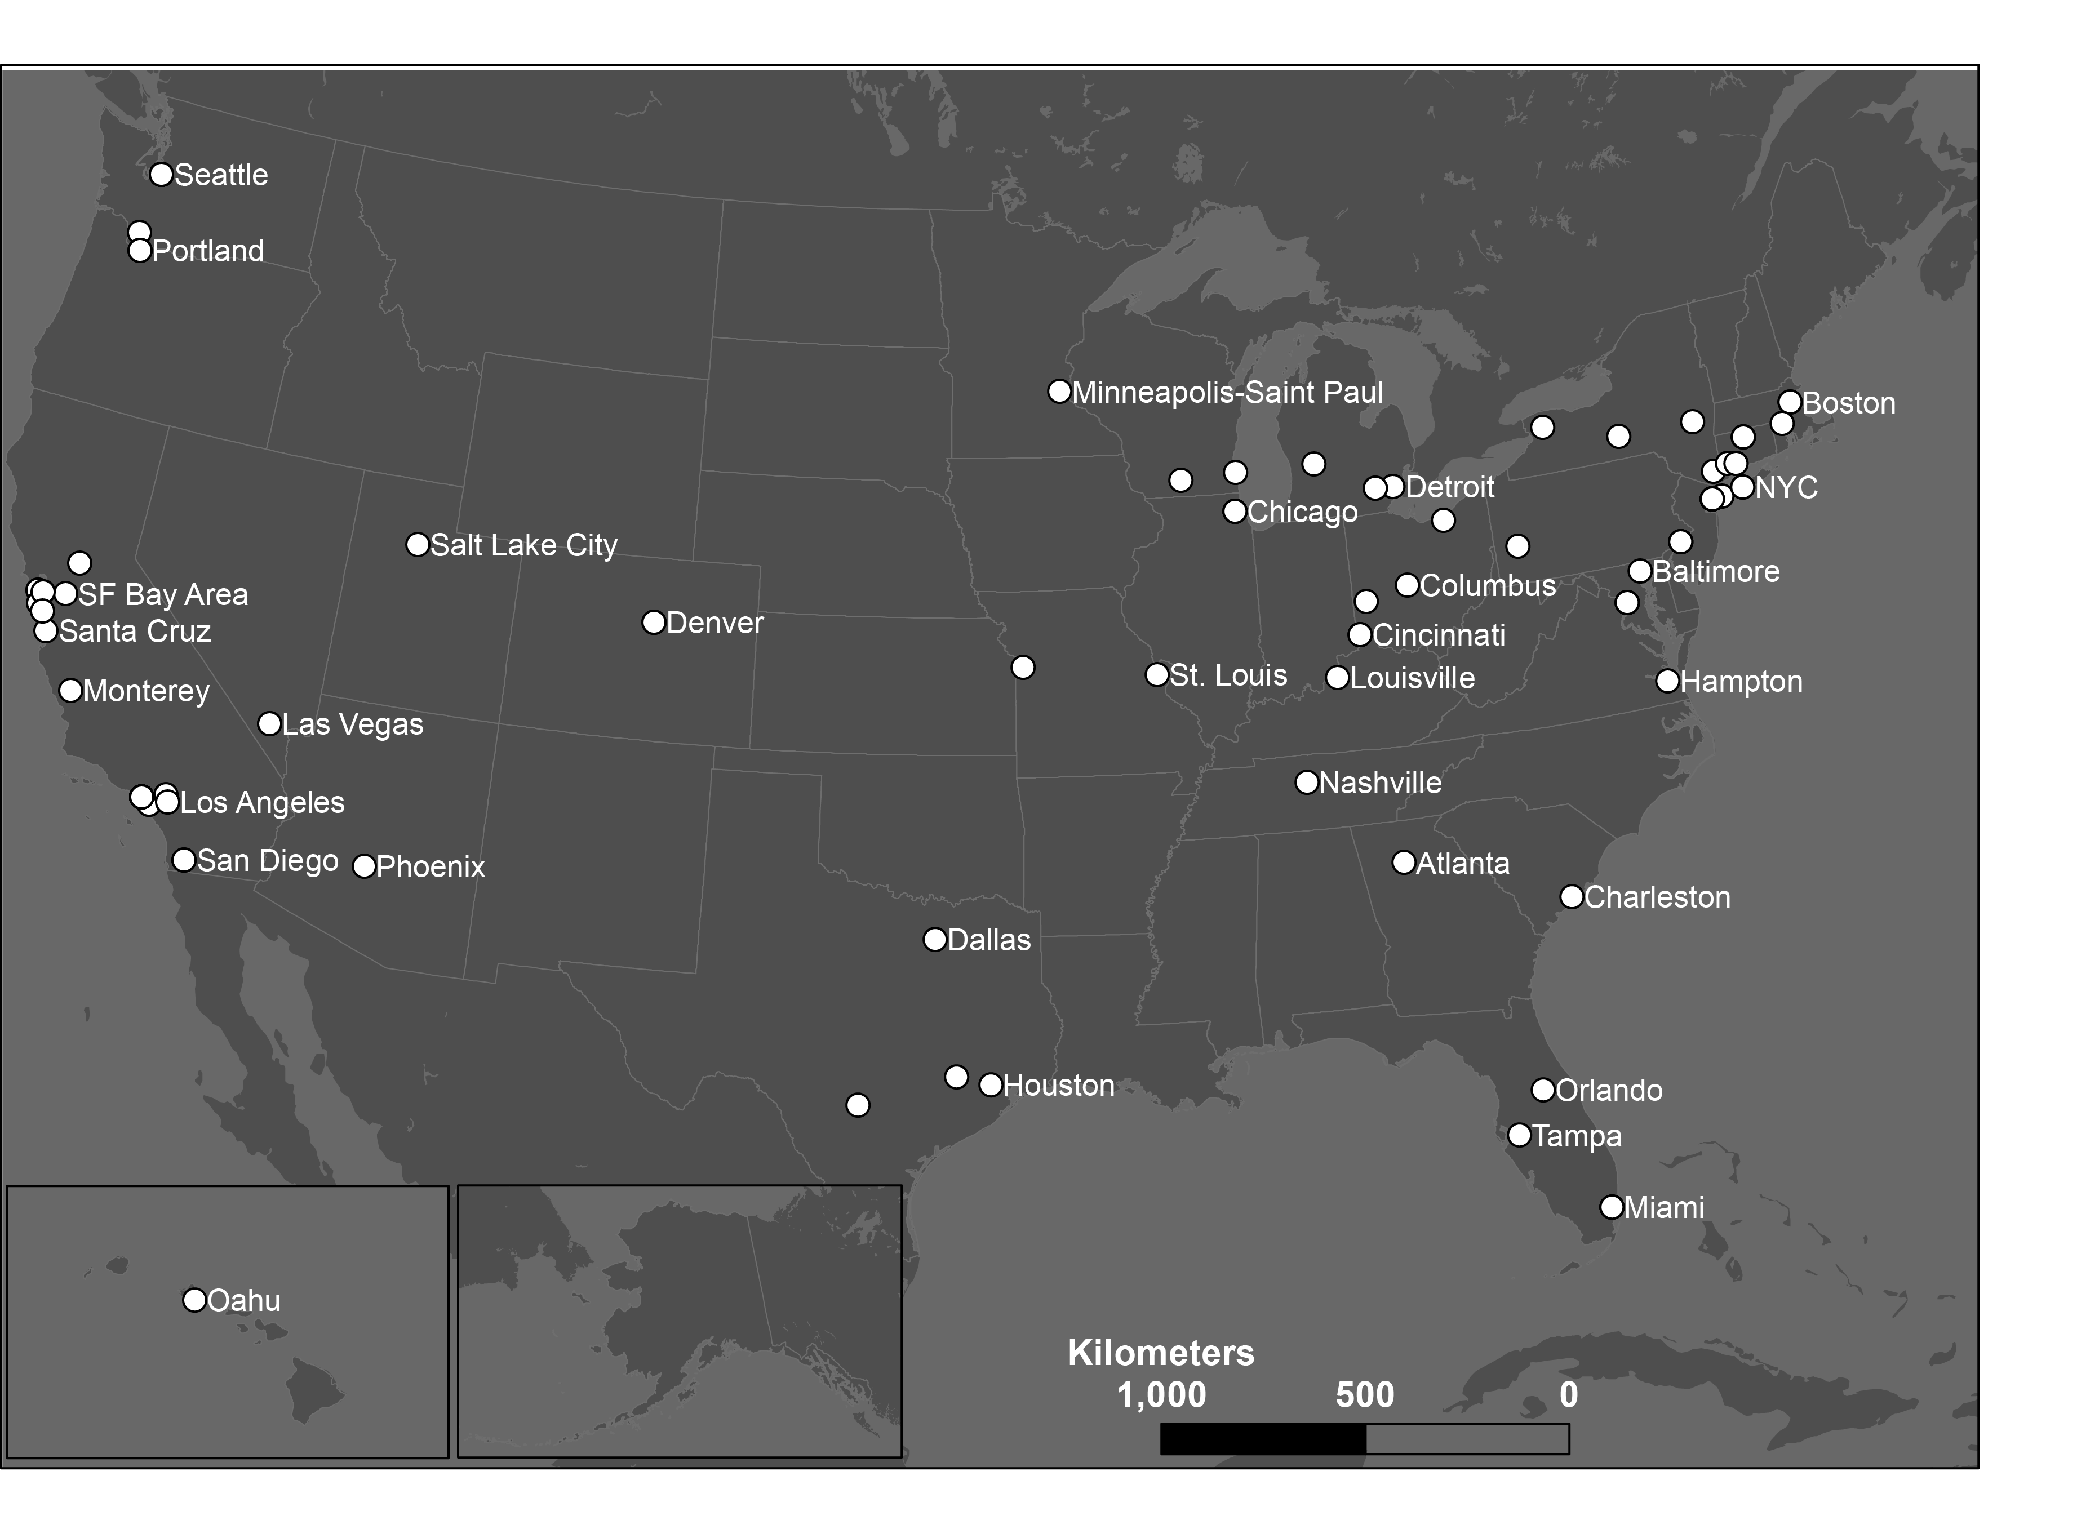
Data – Transit demand
How many people plan and execute their transit trips on their cell phone in a transit system?
113 county-level
transit systems
63 metro areas
28 states
Cell phone activity data from Transit app.

Slide 6
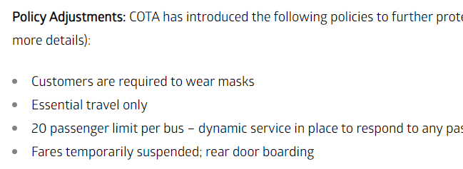
Representativeness?
Very large user base of 1 million.
Paired-T test showed no bias between official data and Transit app data.
Traditional data is not accurate:
Large intrinsic error;
Rear door boarding;
Free riding.

Slide 7
Transit demand during the lockdown

Slide 8
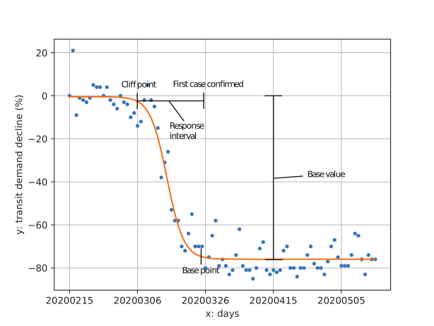
Analyze a transit decline process
Logistic function modeling
Base value: how many people were still using transit during the lockdown
Transit demand decrease in Capital metro, Austin, Texas

Slide 9
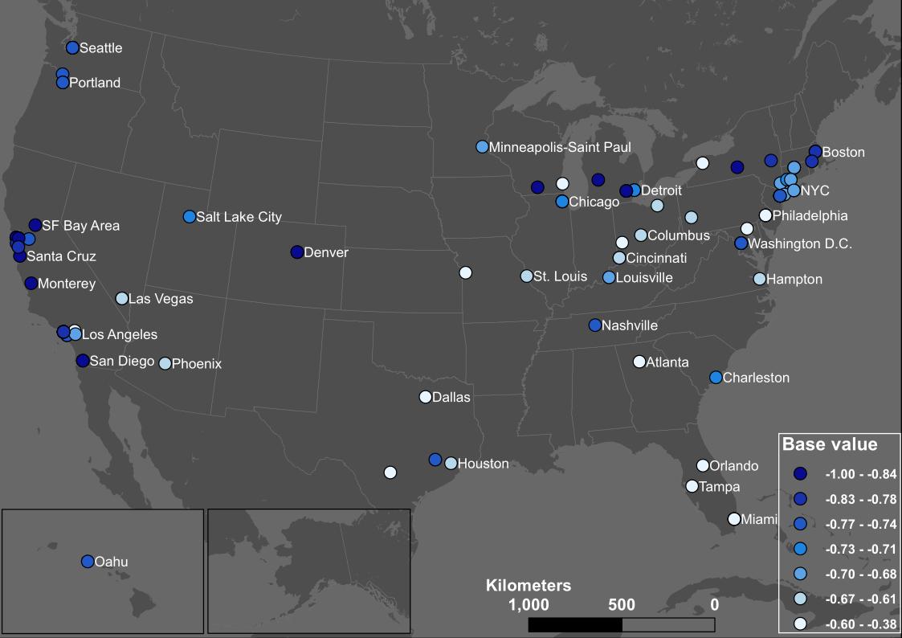
More people using transit
Less people using transit

Slide 10
Who were still using transit?

Slide 11
Who were still using transit - a regression analysis
Four categories of factors contribute to the base value – transit demand during the lockdown.
From high to low R-squared increment:
African-American and women;
Occupation (essential jobs) and Hispanic;
Age (>45 y/o)
Awareness of the pandemic (Google search index)

Slide 12
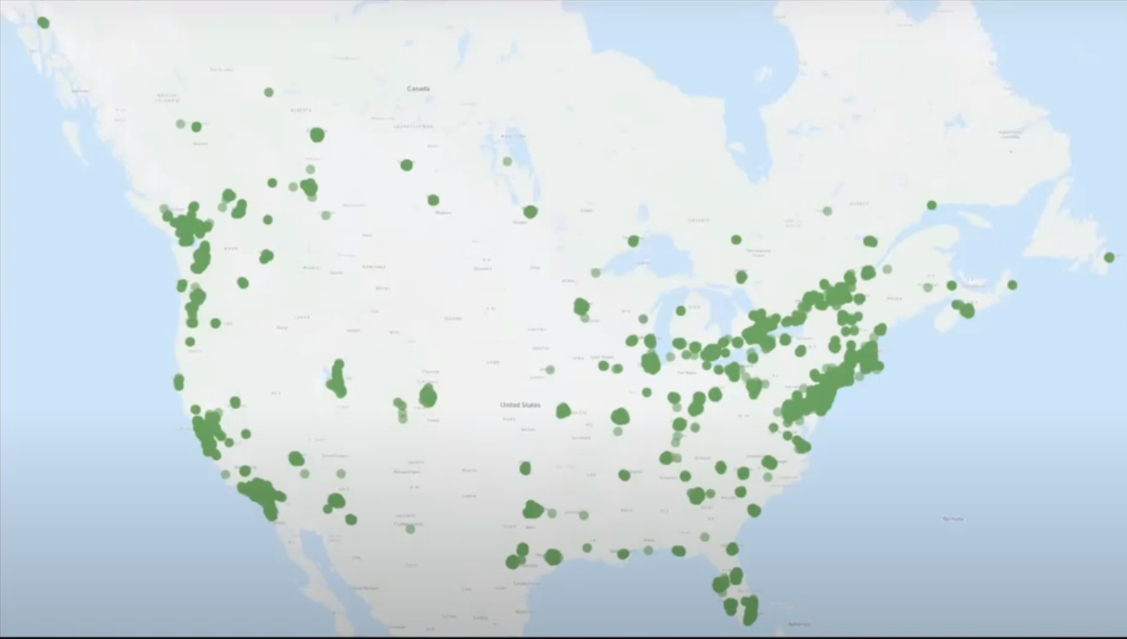
Who were still using transit - a parallel user survey
Transit app conducted a user survey (n = 25,000) on the active users during April.
Source: https://www.youtube.com/watch?v=qkT9XQtd1o4

Slide 13
Who were using transit – African-Americans and Women
Higher ratio of African-American people and Women in a city is correlated with more people used transit during the lockdown.
 | Before | After
African-American | 24% | 37% (+13%)
White | 41% | 23% (-18%)
Male | 50% | 40% (-10%)
Female | 50% | 56% (+6%)
https://medium.com/transit-app/whos-left-riding-public-transit-hint-it-s-not-white-people-d43695b3974a
Notes:
In some cities like Philadelphia, more than 68% of riders are women.

Slide 14
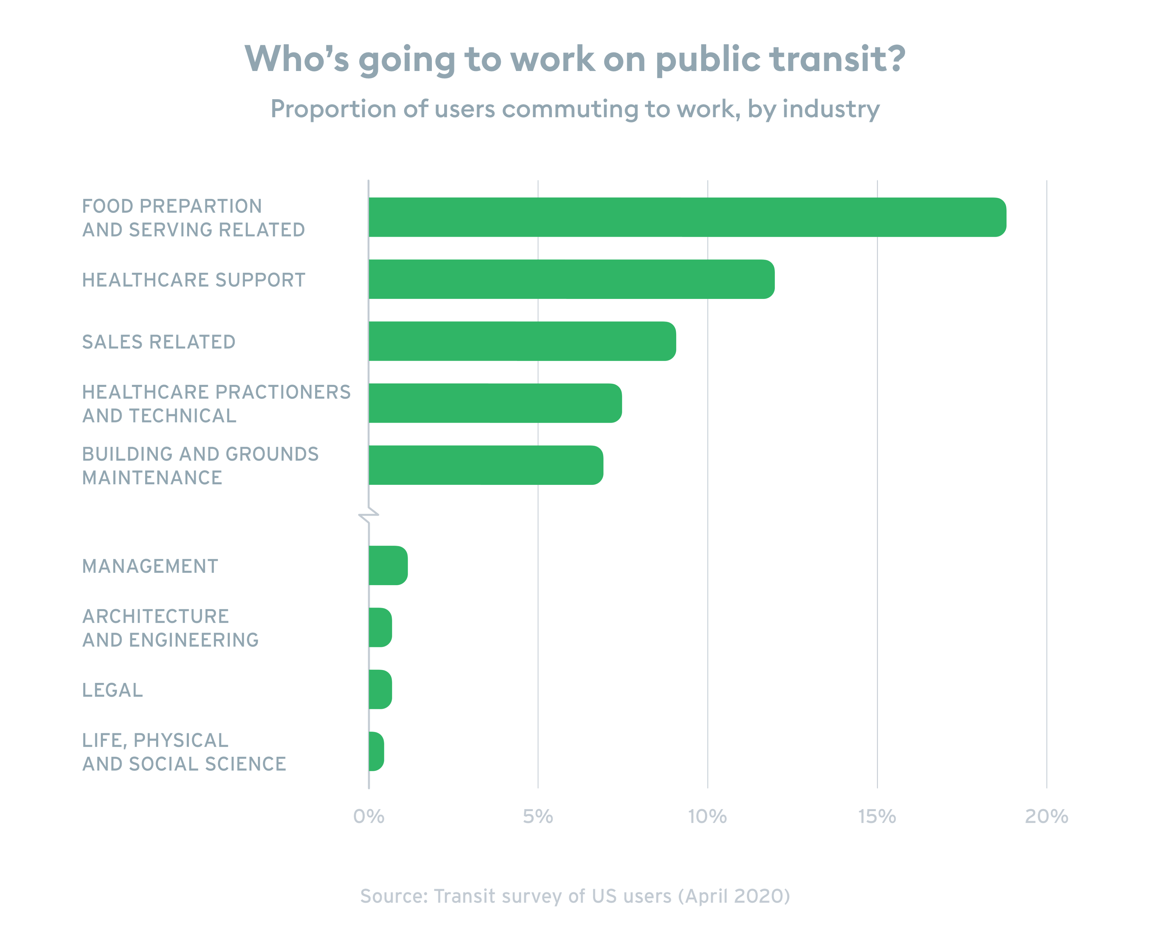
Who were using transit – Essential workers
Higher ratio of essential workers is correlated with more people used transit during the lockdown.
Source: https://medium.com/transit-app/whos-left-riding-public-transit-hint-it-s-not-white-people-d43695b3974a
Notes:
In some cities like Philadelphia, more than 68% of riders are women.

Slide 15
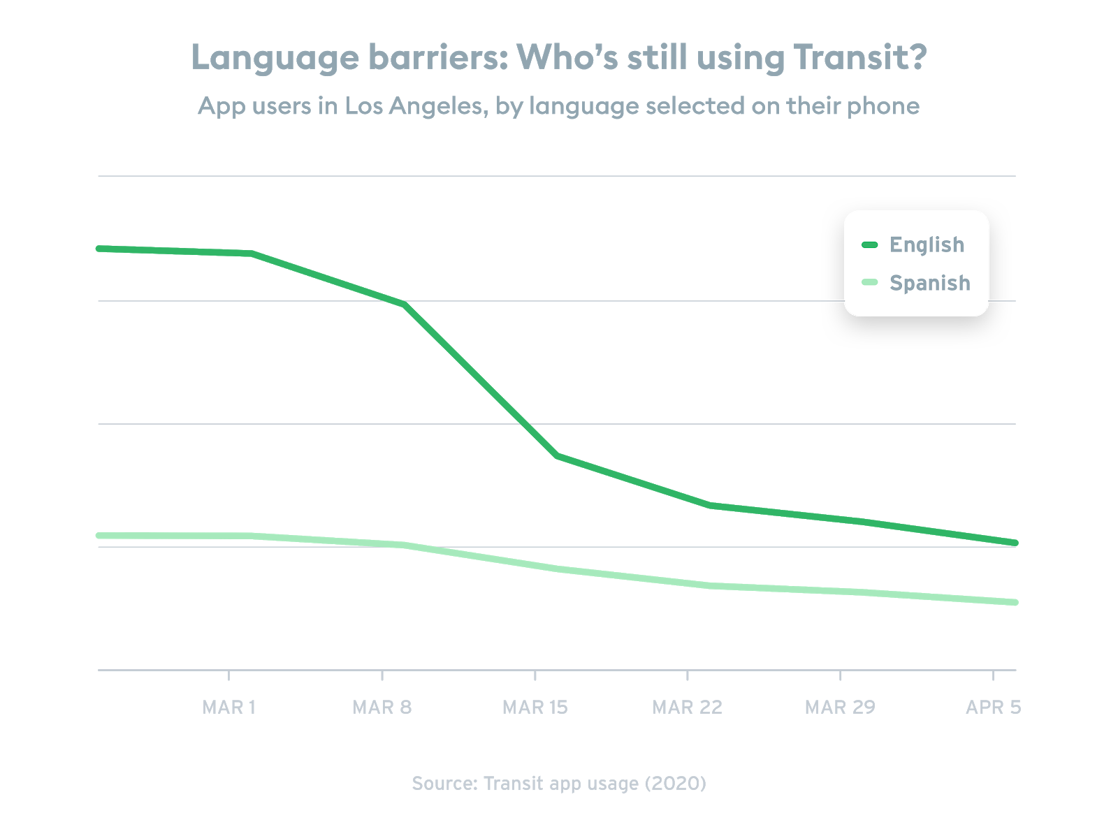
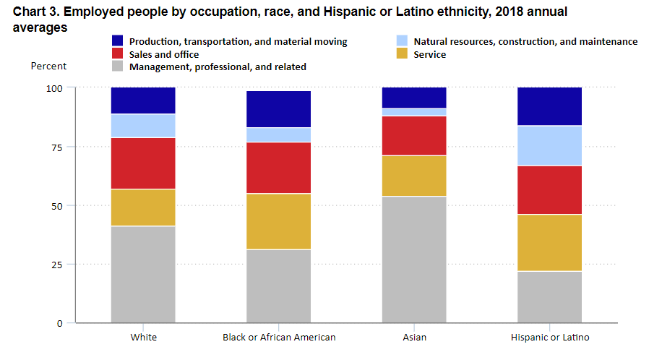
Who were using transit – Hispanic people
Hispanic people have the lowest percent to work remotely.
Source (left): https://www.bls.gov/opub/reports/race-and-ethnicity/2018/home.htm
Source (right): https://medium.com/transit-app/whos-left-riding-public-transit-hint-it-s-not-white-people-d43695b3974a
Notes:
In some cities like Philadelphia, more than 68% of riders are women.

Slide 16
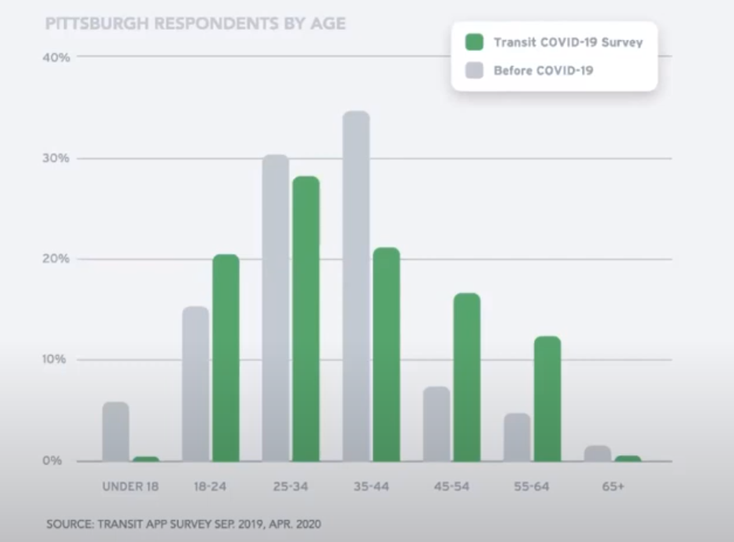
Who were using transit – the senior
Despite the most vulnerable to the virus, more senior people are correlated with higher transit demand
Source: https://www.youtube.com/watch?v=qkT9XQtd1o4

Slide 17
Who were using transit
More people searching “Coronavirus” on Google is correlated with less people using transit – the least important factor in the model.
Your race, your gender, your job, and your age matter more compared to your preference.

Slide 18
How did we respond?

Slide 19
How did we respond?
We compared two important dates: the day to first observe demand decrease (cliff point) and the day of first confirmed case.
Response interval:
how timely did a city respond to the pandemic.

Slide 20
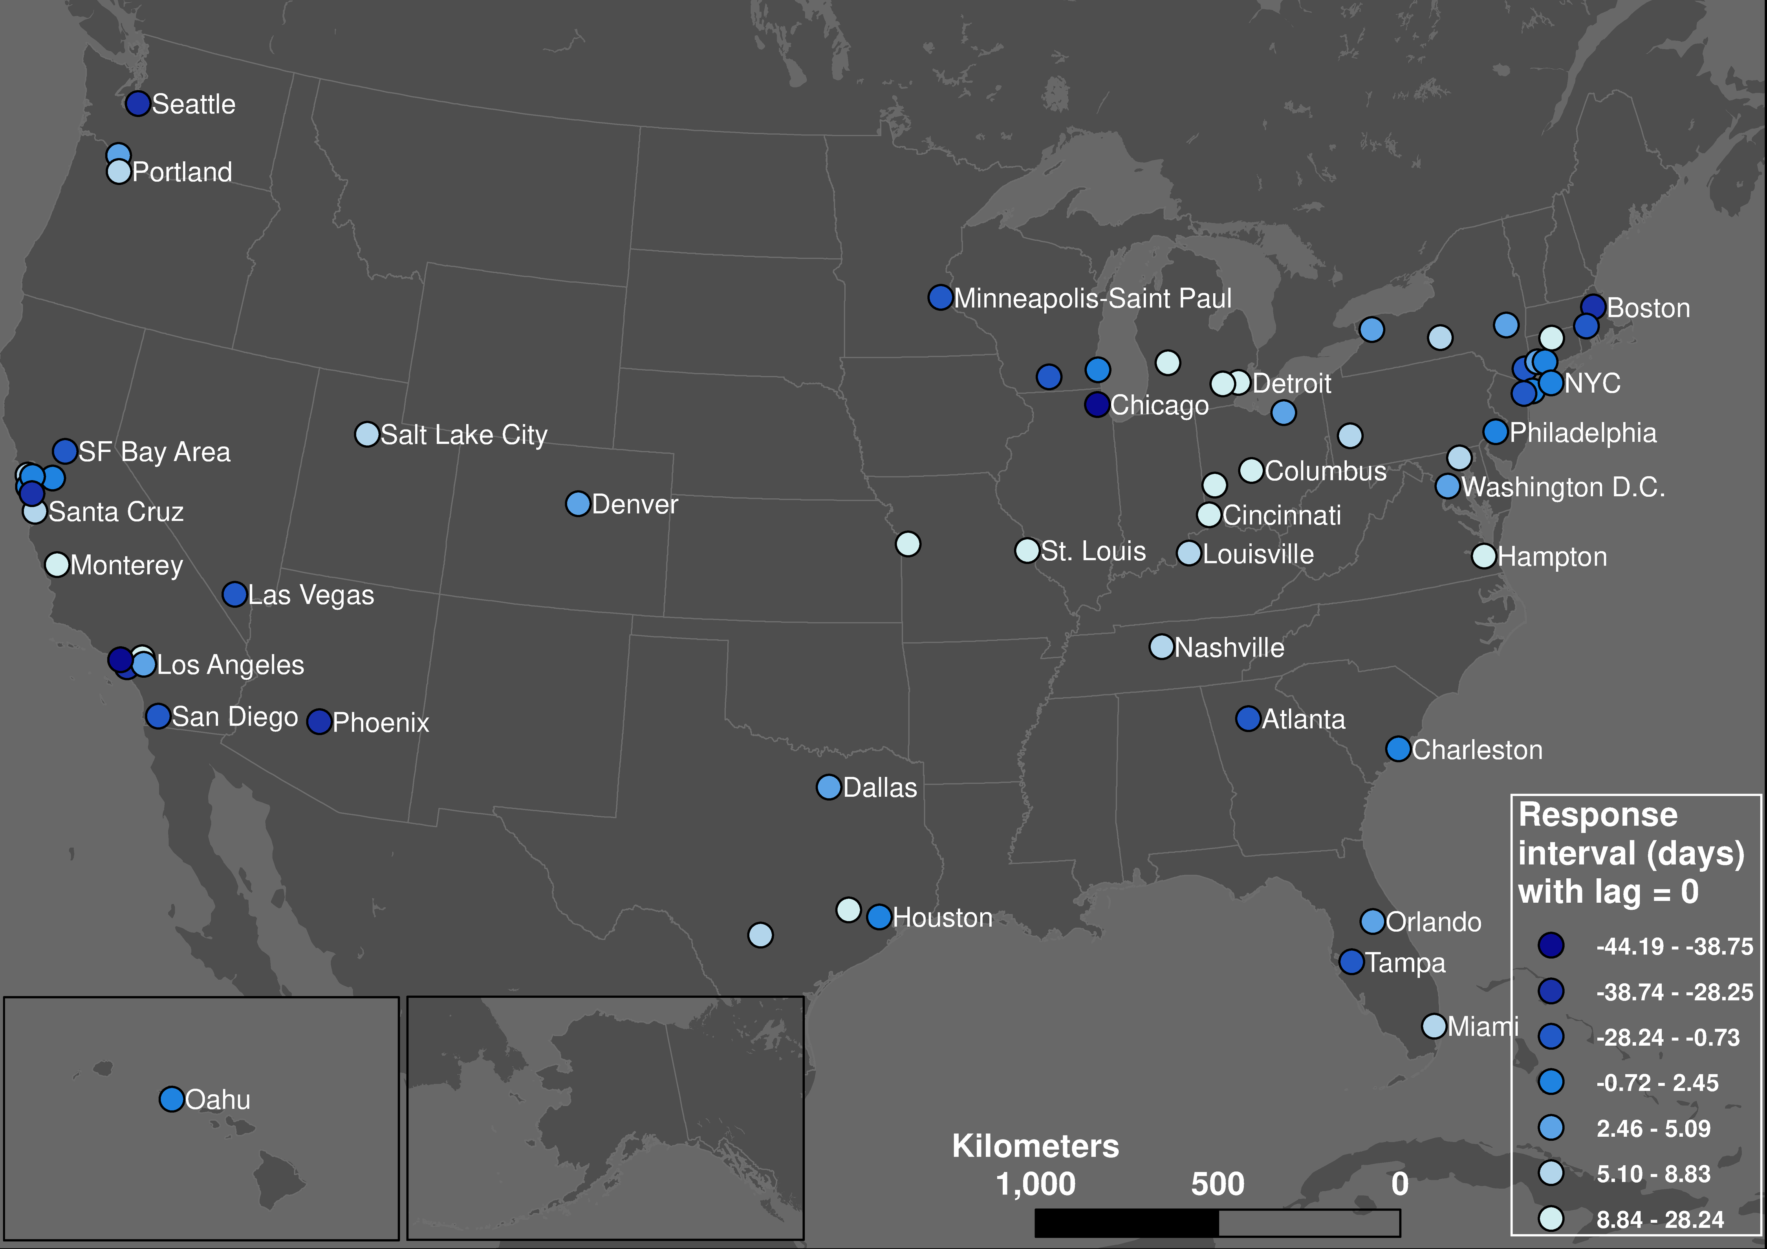
Respond earlier
Respond later

Slide 21
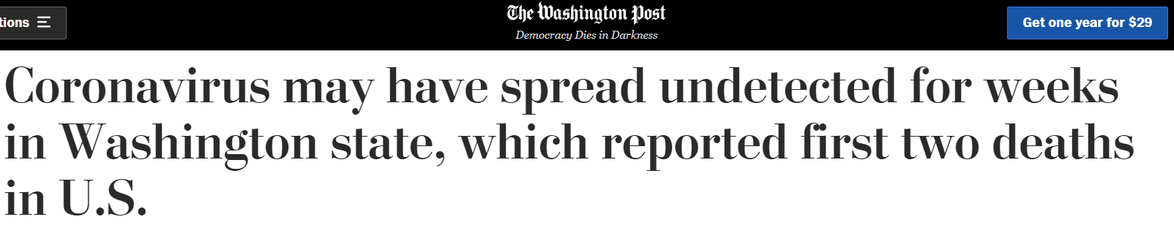
How did we respond, actually?
COVID-19 has an incubation period of 5 – 14 days.
The day of first case confirmed is not the first day when the virus started to spread.
https://www.washingtonpost.com/health/coronavirus-may-have-spread-undetected-for-weeks-in-washington-state/2020/03/01/0f292336-5bcc-11ea-9055-5fa12981bbbf_story.html

Slide 22
Among 113 systems:
For incubation lag = 0, 58% can respond timely
For incubation lag = 5, 32% can respond timely
For incubation lag = 14, only 6.2% can respond timely

Slide 23
Policy matters
Earlier cliff point (the first day to respond) is positively correlated with earlier emergency date.
Transit users’ response times are not synchronized with the evolution of the pandemic, but with the local community’s actions and policies.

Slide 24
How did the pandemic reshape our commuting?

Slide 25
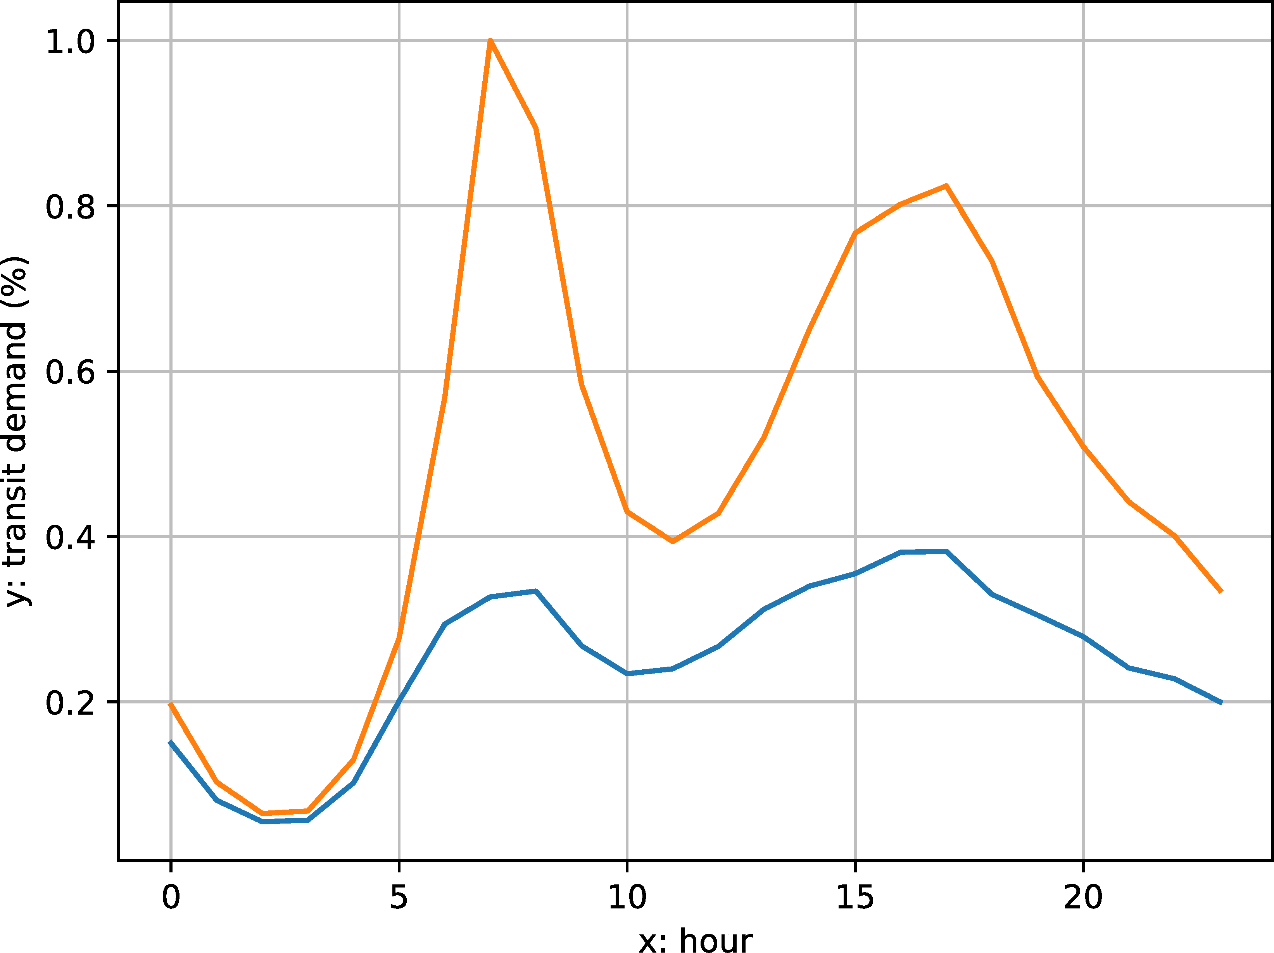
Hourly transit demand profile
Procrustes distance:
The similarity of shapes between the two hourly curves.
How much did our activity routine change
Orange: before COVID; blue: during COVID

Slide 26
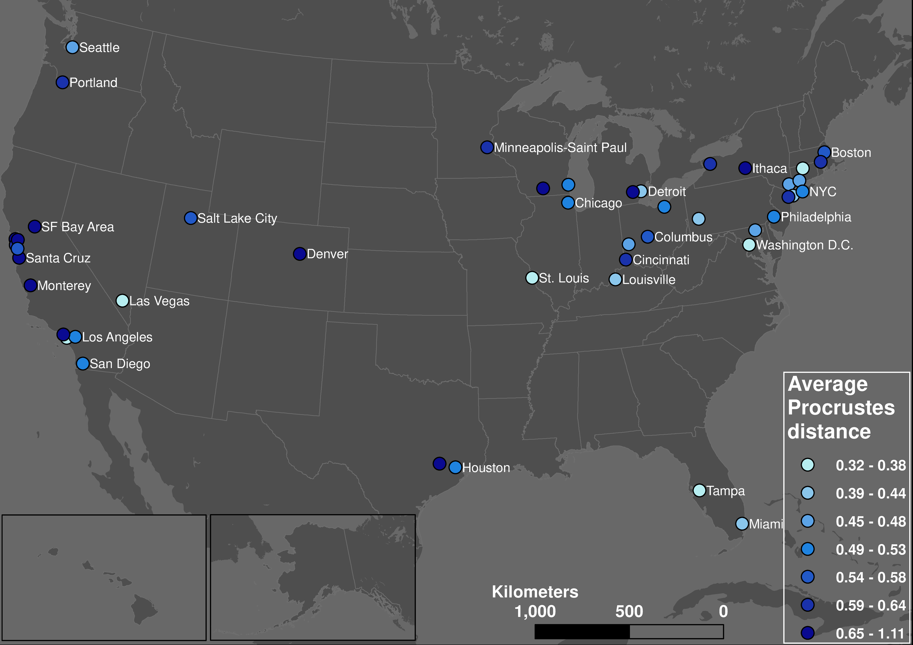
Routine changed less
Routine changed more

Slide 27
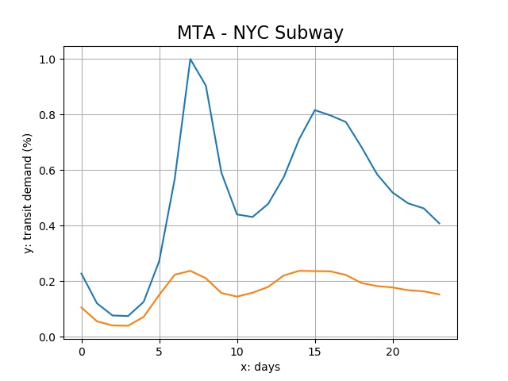
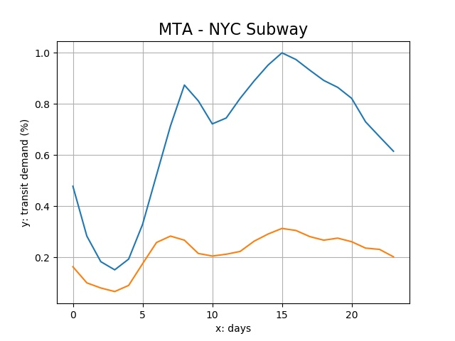
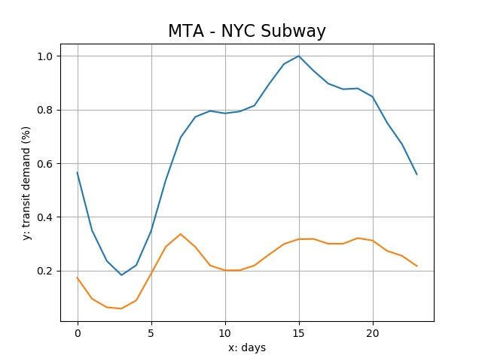
Reshaped week routines
Privileged population’s leave on weekdays made weekdays more like weekends;
Underprivileged population’s stay on weekends made weekends more like weekdays.
Friday
Saturday
Sunday

Slide 28
What do we learn?

Slide 29
Public transit is essential
People need transit systems, even during lockdown.
These people are the vulnerable, the minorities, the poor, and the ones who have no choice.
Your awareness hardly matters compared to other factors.
Public transit should not be a business, but an essential social infrastructure.
Notes:
We may want to think twice before complaining about zoom calls.

Slide 30
Rethink our response
In general, we were late.
Timely policies enacted by the local authorities did make an impact.
Mobility is not independent. Mobility research should not be independent. Mobility policy should not be independent.

Slide 31

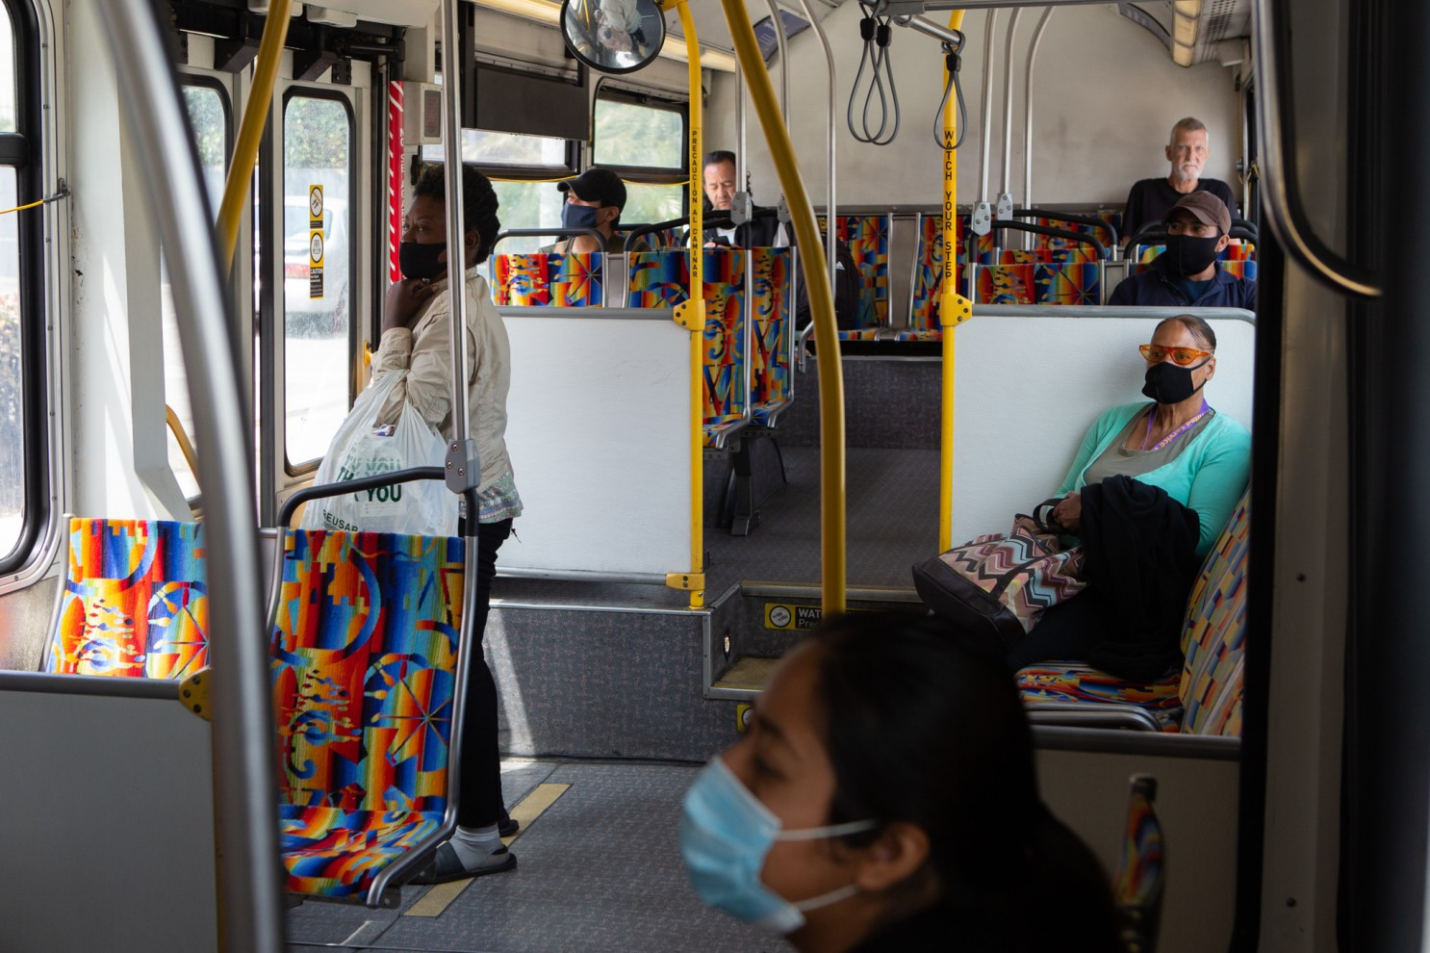
Through the façade
Who is here to stay? The most essential and the most vulnerable.
Rethink future public transit investment/policy’s priority.
Source: https://www.transportation.gov/sites/dot.gov/files/2021-01/USDOT_AVCP.pdf
Source: https://www.latimes.com/opinion/story/2020-08-16/public-transit-bailout
Notes:
So 1900!

Slide 32
Thanks!
liu.6544@osu.edu

Slide 33
Data representativeness
Cell phone ownership rate of US adults is 96% and 81% for smartphone as of Feb 2019.
 | Cell phone | Smartphone
Total | 96% | 81%
Women | 95% | 79%
African-Americans | 98% | 80%
Hispanic | 96% | 79%
Less than $30000 | 95% | 71%

Slide 34
Implications of underestimating
With the data sample skewed to the privileged population, the underprivileged population are still significant in the model.
If more underprivileged population were added, it would only make the model and the conclusions more significant.
More local-level research will better answer the questions.

